Slide 1

Chapter 10
Error Detection and Correction
10.‹#›
Copyright © The McGraw-Hill Companies, Inc. Permission required for reproduction or display.
Notes:
‹#›

Slide 2

Note
Data can be corrupted during transmission.
Some applications require that errors be detected and corrected.
10.‹#›
Notes:
‹#›

Slide 3
10-1 INTRODUCTION
Let us first discuss some issues related, directly or indirectly, to error detection and correction.
Topics discussed in this section:
Types of Errors Redundancy Detection Versus Correction Forward Error Correction Versus Retransmission Coding
Modular Arithmetic
10.‹#›
Notes:
‹#›

Slide 4
Note
In a single-bit error, only 1 bit in the data unit has changed.
10.‹#›
Notes:
‹#›

Slide 5
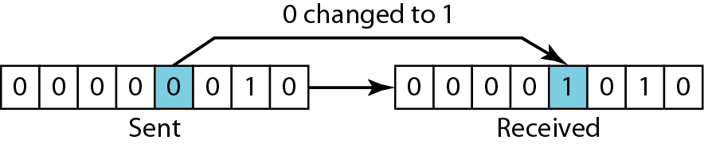
Figure 10.1 Single-bit error
10.‹#›
Notes:
‹#›

Slide 6
Note
A burst error means that 2 or more bits in the data unit have changed.
10.‹#›
Notes:
‹#›

Slide 7
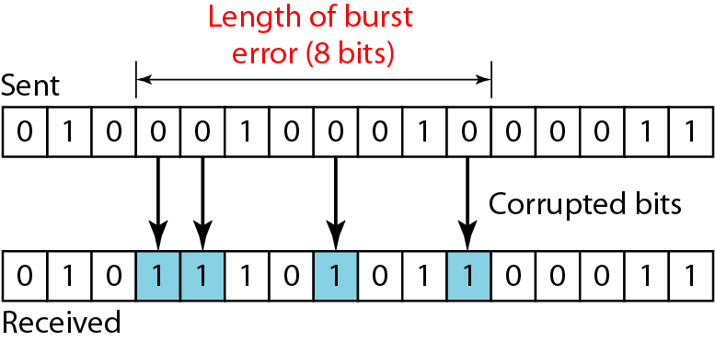
Figure 10.2 Burst error of length 8
10.‹#›
Notes:
‹#›

Slide 8
Redundancy
The central concept in error detection and correction
The redundant bits are added by the sender and removed by the receiver
Their presence helps the receiver to detect and correct corrupted bits
10.‹#›

Slide 9
Redundancy
Note
To detect or correct errors, we need to send extra (redundant) bits with data.
10.‹#›
Notes:
‹#›

Slide 10
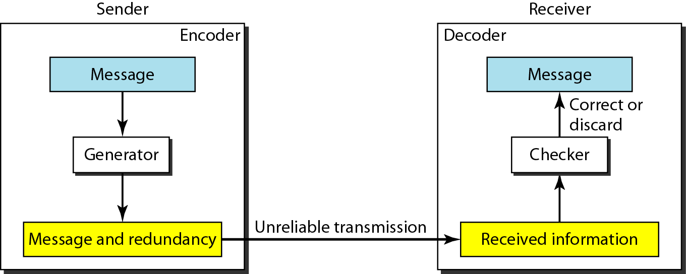
Figure 10.3 The structure of encoder and decoder
10.‹#›
Notes:
‹#›

Slide 11
Coding
Redundancy is achieved through various coding schemes
The coding schemes are divided into two broad categories
Block coding
Convolution coding
10.‹#›

Slide 12
Note
In this book, we concentrate on block codes; we leave convolution codes to advanced texts.
10.‹#›
Notes:
‹#›

Slide 13
Note
In modulo-N arithmetic, we use only the integers in the range 0 to N −1, inclusive.
10.‹#›
Notes:
‹#›

Slide 14
10-2 BLOCK CODING
In block coding, we divide our message into blocks, each of k bits, called datawords. We add r redundant bits to each block to make the length n = k + r. The resulting n-bit blocks are called codewords.
Topics discussed in this section:
Error Detection Error Correction Hamming Distance
Minimum Hamming Distance
10.‹#›
Notes:
‹#›

Slide 15
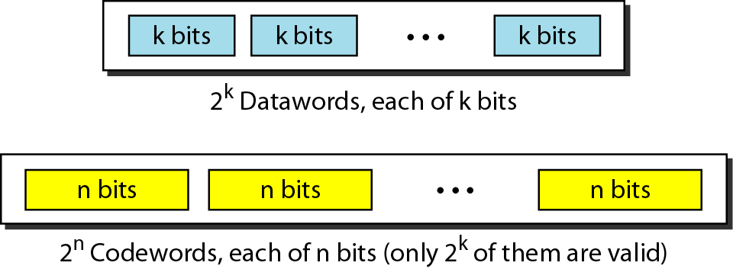
Figure 10.5 Datawords and codewords in block coding
10.‹#›
Notes:
‹#›

Slide 16
Example 10.1
The 4B/5B block coding discussed in Chapter 4 is a good example of this type of coding. In this coding scheme, k = 4 and n = 5. As we saw, we have 2^{k} = 16 datawords and 2^{n} = 32 codewords. We saw that 16 out of 32 codewords are used for message transfer and the rest are either used for other purposes or unused.
10.‹#›
Notes:
‹#›

Slide 17
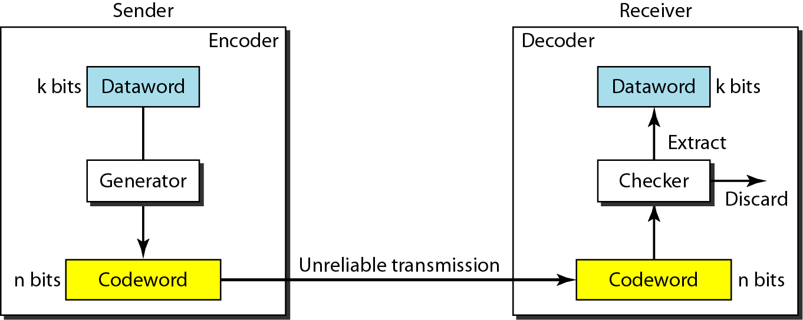
Figure 10.6 Process of error detection in block coding
10.‹#›
Notes:
‹#›

Slide 18
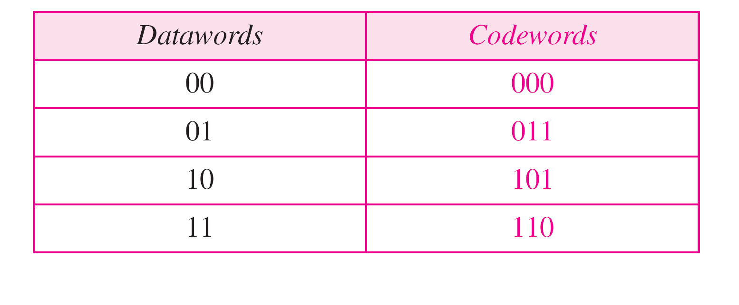
Table 10.1 A code for error detection (Example 10.2)
10.‹#›
Notes:
‹#›

Slide 19
Example 10.2
Let us assume that k = 2 and n = 3. Table 10.1 shows the list of datawords and codewords. Later, we will see how to derive a codeword from a dataword.
Assume the sender encodes the dataword 01 as 011 and
sends it to the receiver. Consider the following cases:
1. The receiver receives 011. It is a valid codeword. The receiver extracts the dataword 01 from it.
10.‹#›
Notes:
‹#›

Slide 20
Example 10.2 (continued)
2. The codeword is corrupted during transmission, and 111 is received. This is not a valid codeword and is discarded.
3. The codeword is corrupted during transmission, and 000 is received. This is a valid codeword. The receiver incorrectly extracts the dataword 00.
Thus two corrupted bits have made the error undetectable.
10.‹#›
Notes:
‹#›

Slide 21
Note
An error-detecting code can detect only the types of errors for which it is designed; other types of errors may remain undetected.
10.‹#›
Notes:
‹#›

Slide 22
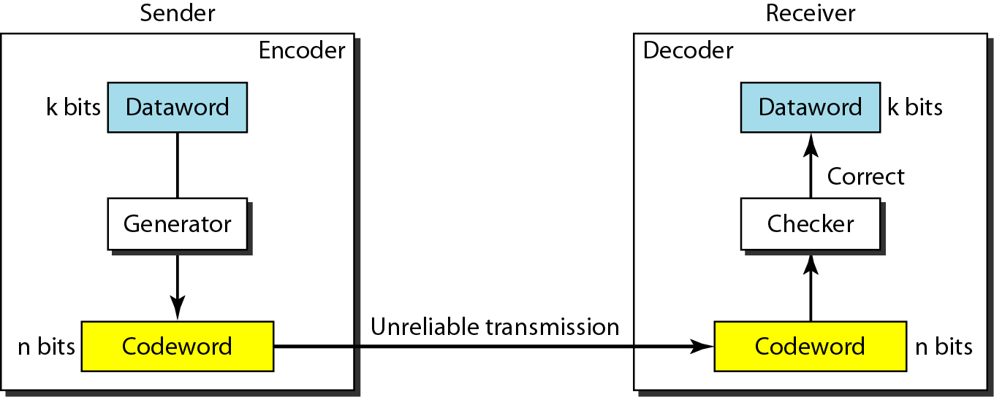
Figure 10.7 Structure of encoder and decoder in error correction
10.‹#›
Notes:
‹#›

Slide 23
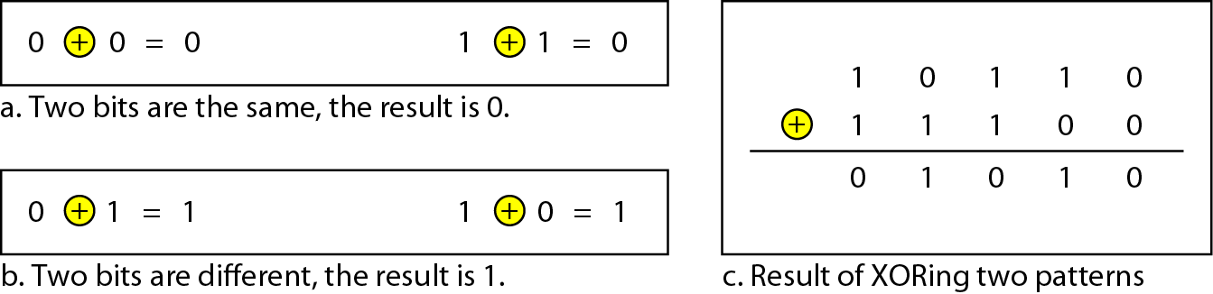
Figure 10.4 XORing of two single bits or two words
10.‹#›
Notes:
‹#›

Slide 24
Note
The Hamming distance between two words is the number of differences between corresponding bits.
10.‹#›
Notes:
‹#›

Slide 25

Example 10.4
Let us find the Hamming distance between two pairs of words.
1. The Hamming distance d(000, 011) is 2 because
2. The Hamming distance d(10101, 11110) is 3 because
10.‹#›
Notes:
‹#›

Slide 26
Note
The minimum Hamming distance is the smallest Hamming distance between all possible pairs in a set of words.
10.‹#›
Notes:
‹#›

Slide 27
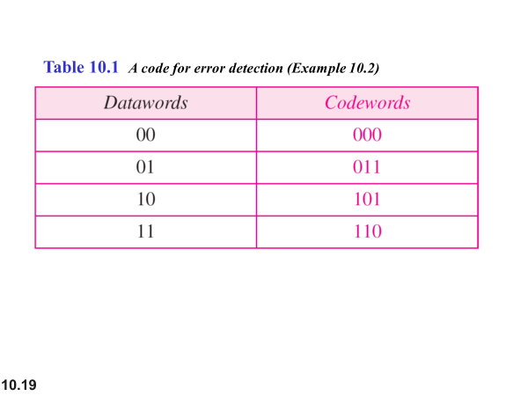
10.‹#›

Slide 28
There are four different codewords which can have 6 possible pairs
(000, 011)
(000, 101)
(000, 110)
(011, 101)
(011, 110)
(101.110)
10.‹#›

Slide 29
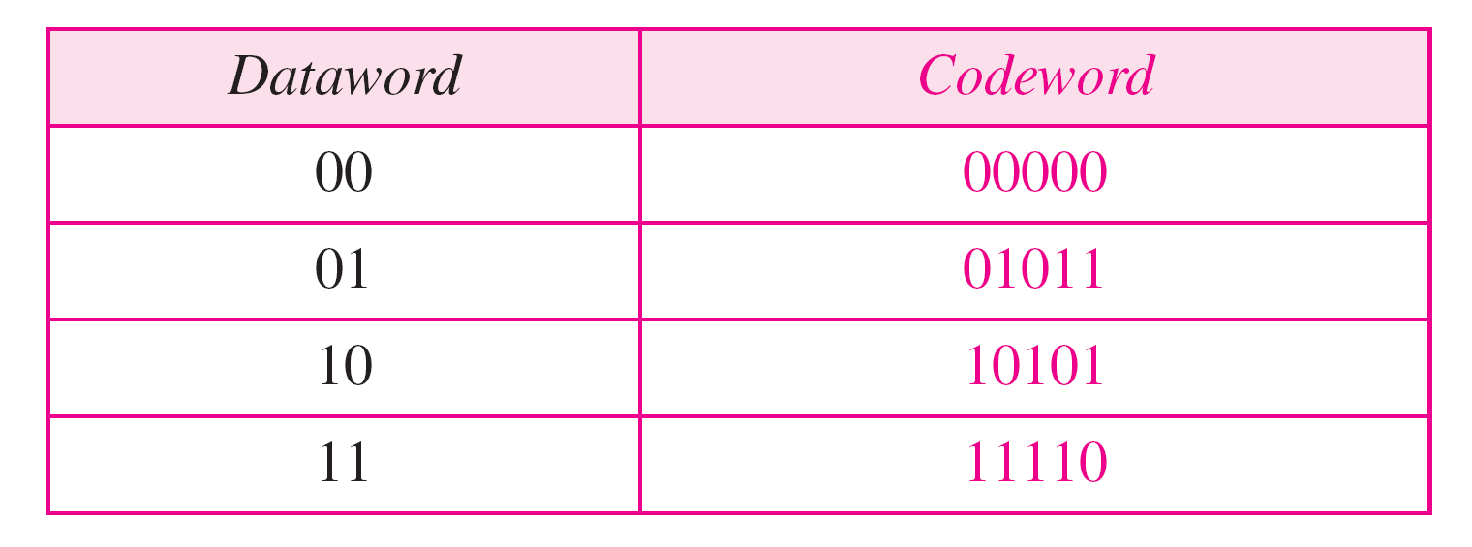
Table 10.2 A code for error correction (Example 10.3)
10.‹#›
Notes:
‹#›

Slide 30
Example 10.6
Find the minimum Hamming distance of the coding scheme in Table 10.2.
Solution
We first find all the Hamming distances.
The d_{min} in this case is 3.
10.‹#›
Notes:
‹#›

Slide 31
Note
To guarantee the detection of up to s errors in all cases, the minimum
Hamming distance in a block code must be d_{min} = s + 1.
10.‹#›
Notes:
‹#›

Slide 32
Note
To guarantee the correction of up to t errors in all cases, the minimum
Hamming distance in a block code must be d_{min} = 2t + 1.
10.‹#›
Notes:
‹#›

Slide 33
Example 10.9
A code scheme has a Hamming distance d_{min} = 4. What is the error detection and correction capability of this scheme?
Solution
This code guarantees the detection of up to three errors (s = 3), but it can correct up to one error. In other words, if this code is used for error correction, part of its capability is wasted. Error correction codes need to have an odd minimum distance (3, 5, 7, . . . ).
10.‹#›
Notes:
‹#›

Slide 34
10-4 CYCLIC CODES
Cyclic codes are special linear block codes with one extra property. In a cyclic code, if a codeword is cyclically shifted (rotated), the result is another codeword.
Topics discussed in this section:
Cyclic Redundancy Check Hardware Implementation Polynomials Cyclic Code Analysis
Advantages of Cyclic Codes Other Cyclic Codes
10.‹#›
Notes:
‹#›

Slide 35
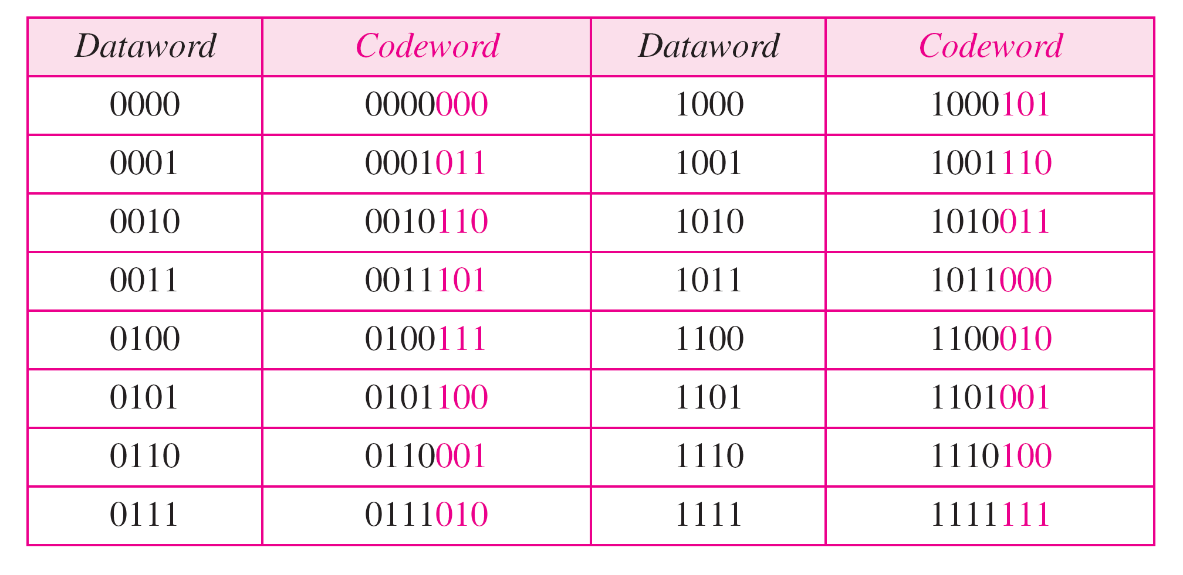
Table 10.6 A CRC code with C(7, 4)
10.‹#›
Notes:
‹#›

Slide 36
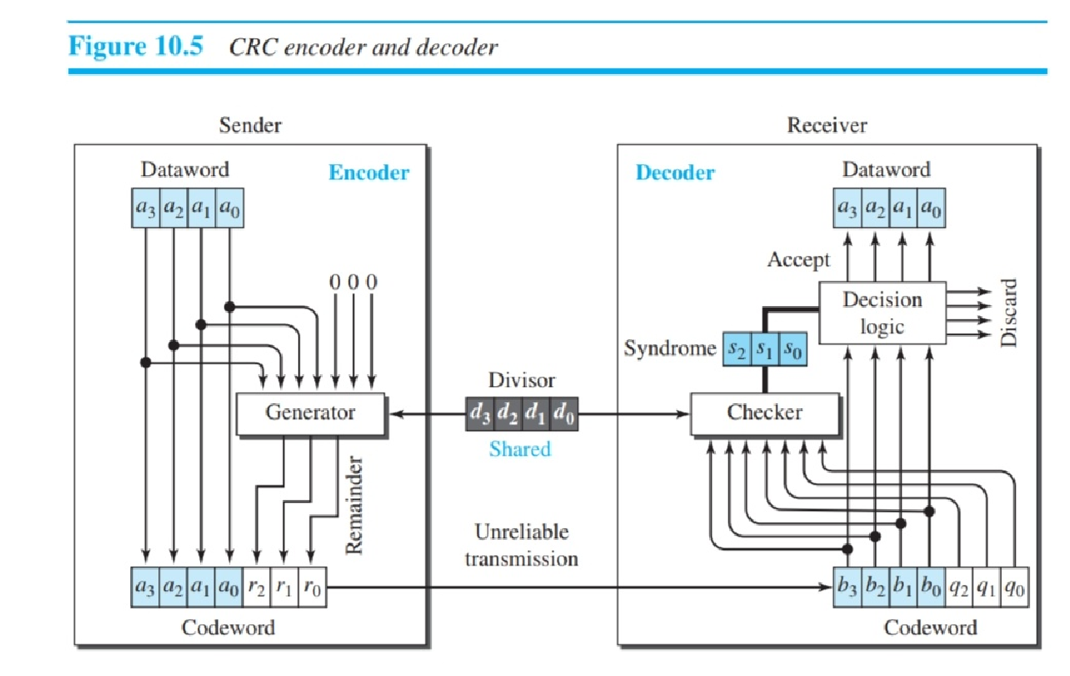
10.‹#›

Slide 37
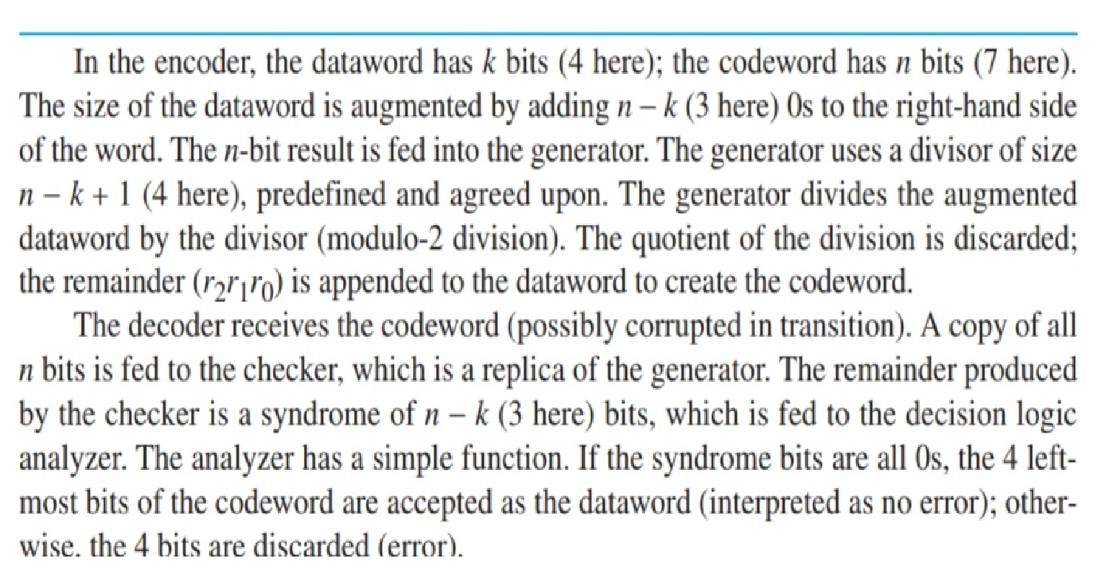
10.‹#›

Slide 38
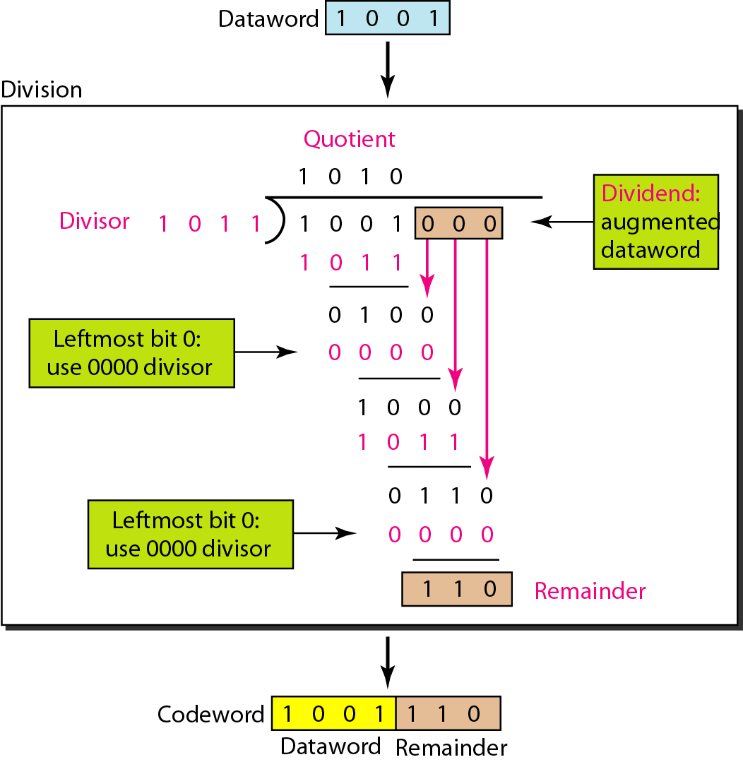
Figure 10.15 Division in CRC encoder
10.‹#›
Notes:
‹#›

Slide 39
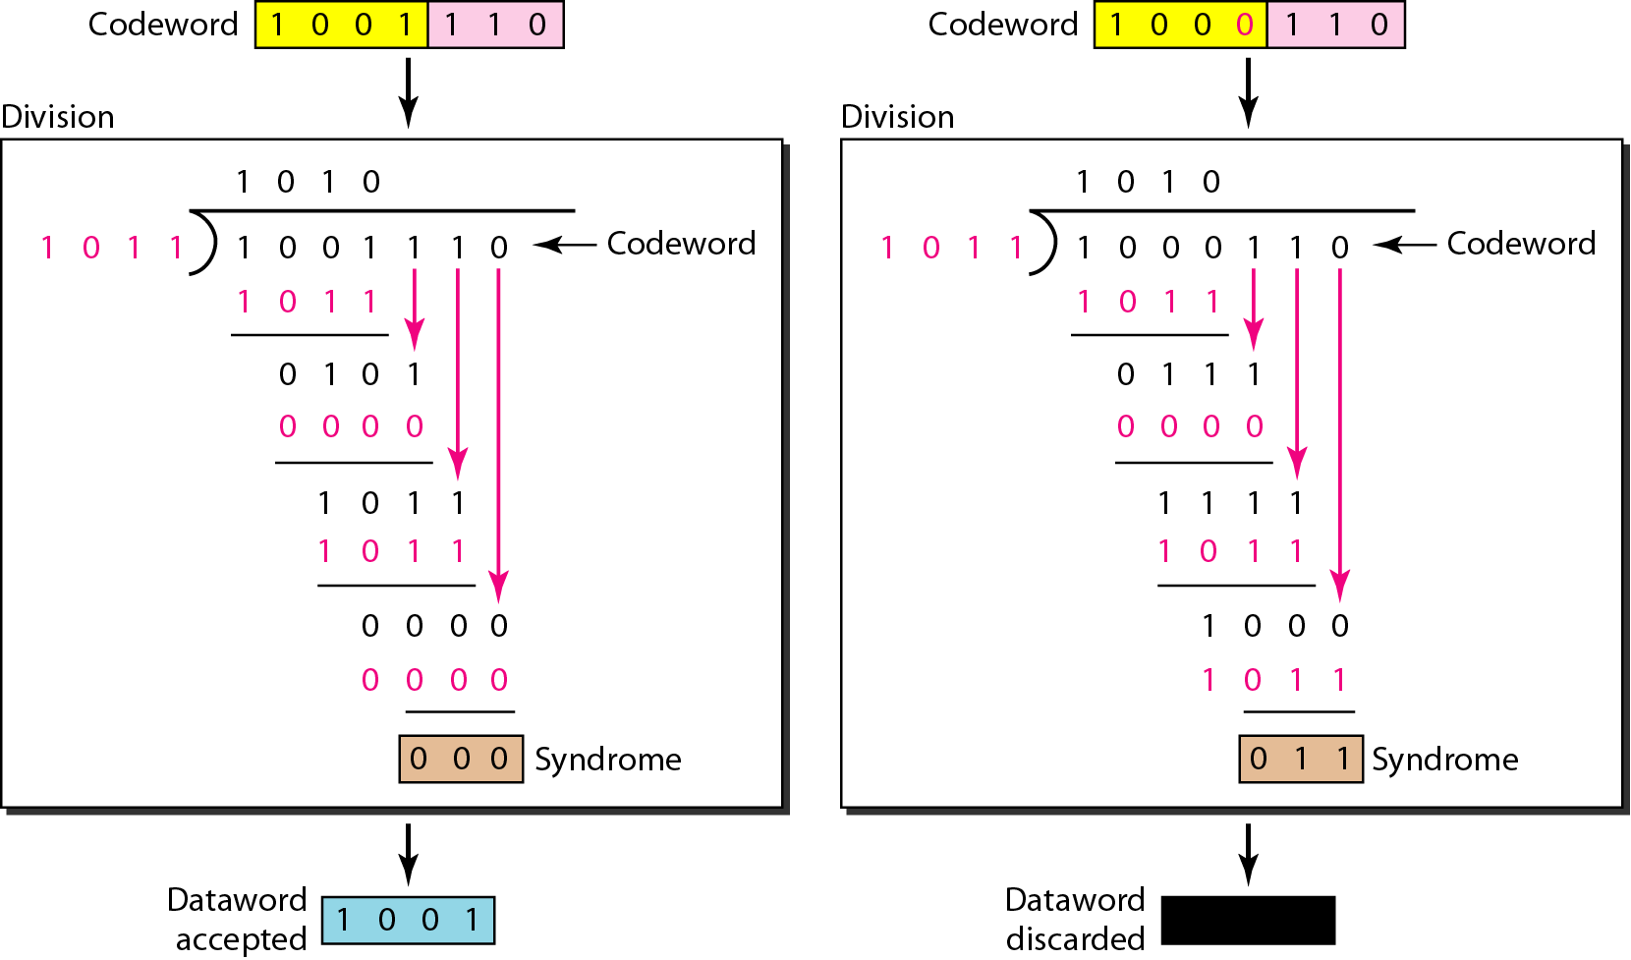
Figure 10.16 Division in the CRC decoder for two cases
10.‹#›
Notes:
‹#›

Slide 40
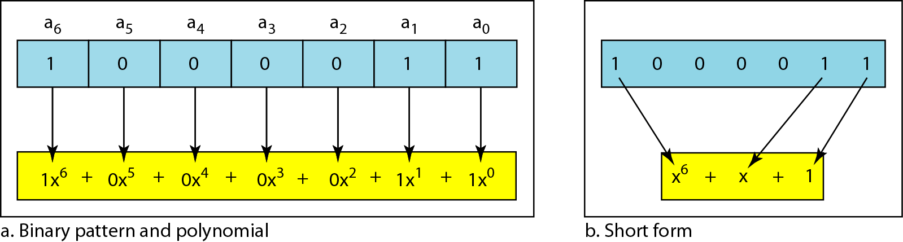
Figure 10.21 A polynomial to represent a binary word
10.‹#›
Notes:
‹#›

Slide 41
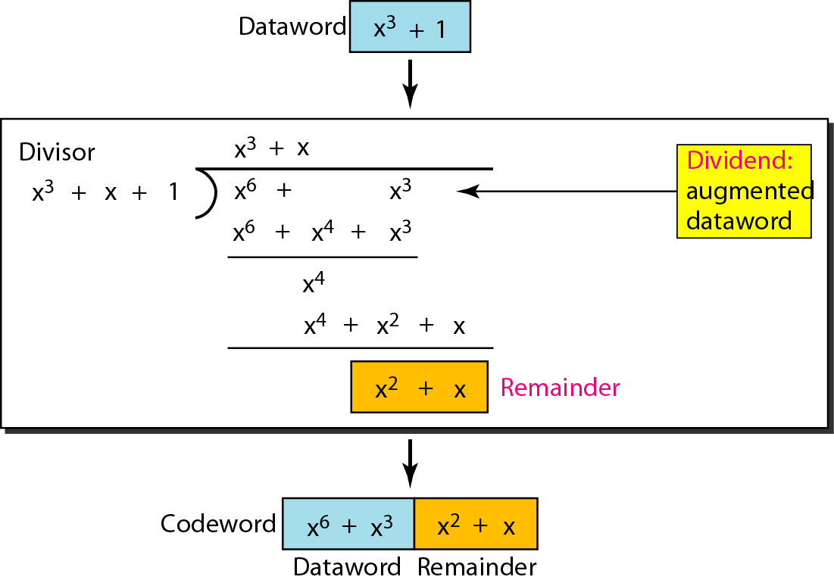
Figure 10.22 CRC division using polynomials
10.‹#›
Notes:
‹#›

Slide 42
Note
The divisor in a cyclic code is normally called the generator polynomial
or simply the generator.
10.‹#›
Notes:
‹#›

Slide 43
Dataword: d(x)
Syndrome: s(x)
Codeword: c(x)
Error: e(x)
Generator: g(x)
10.‹#›

Slide 44
Note
In a cyclic code,
If s(x) ≠ 0, one or more bits is corrupted.
If s(x) = 0, either
a. No bit is corrupted. or
b. Some bits are corrupted, but the decoder failed to detect them.
10.‹#›
Notes:
‹#›

Slide 45
Note
In a cyclic code, those e(x) errors that are divisible by g(x) are not caught.
10.‹#›
Notes:
‹#›

Slide 46
Note
If the generator has more than one term and the coefficient of x⁰ is 1, all single errors can be caught.
10.‹#›
Notes:
‹#›

Slide 47
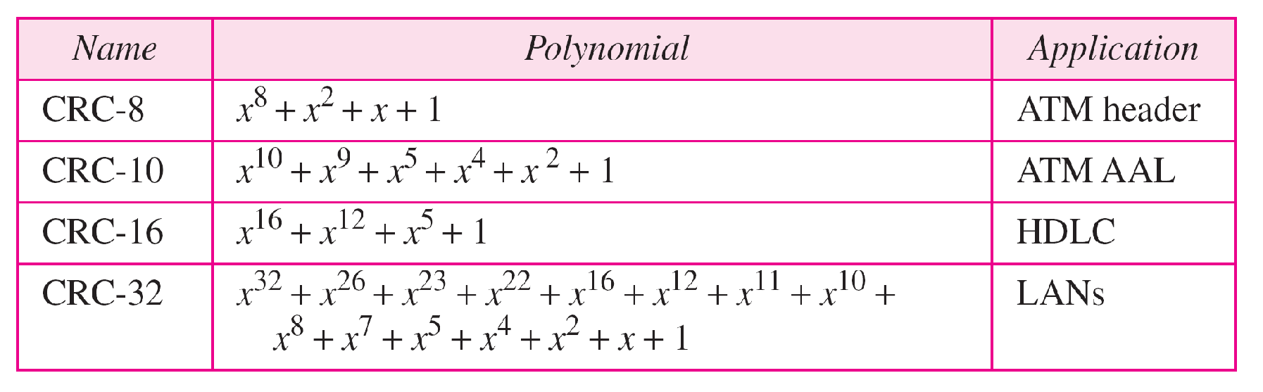
Table 10.7 Standard polynomials
10.‹#›
Notes:
‹#›

